Slide 1


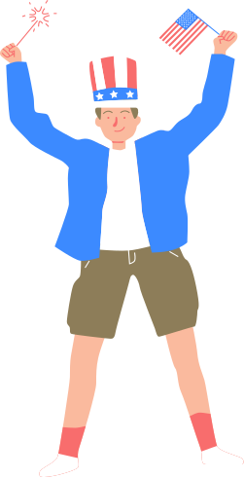
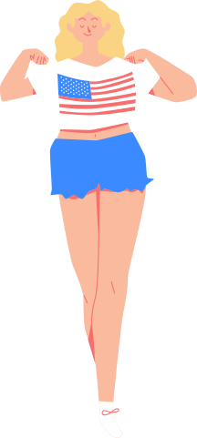
Secretary of State’s Office
Voting
& Civics
Preparation for
Young People

Slide 2



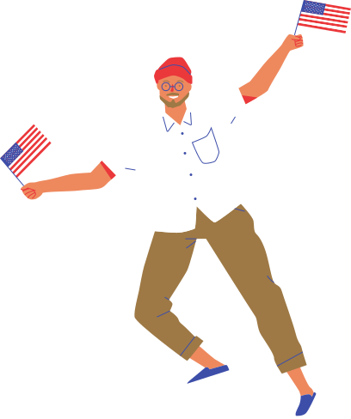
Table Of Contents
  Secretary of State’s Office – What We Do
  The Right to Vote has Been a Struggle – Exercise Your Right
  Lots of Ways to Participate – Use Them!
  Key General Election Dates in 2024

Slide 3
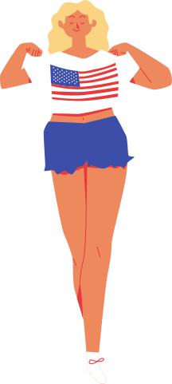
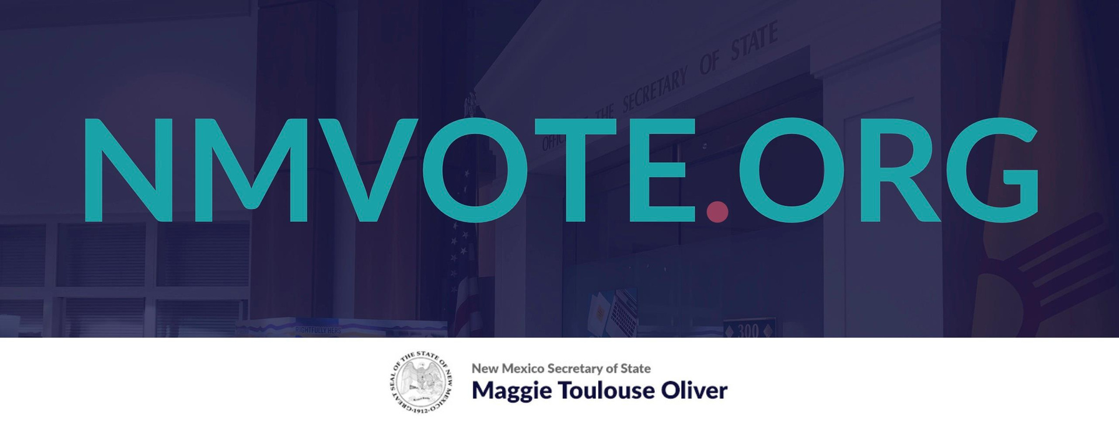
New Mexico Secretary of State’s Office
Notes:
At the Secretary of State’s Office, we oversee election administration in NM.
Each county has a county clerk. And they run the elections on the ground.

Slide 4
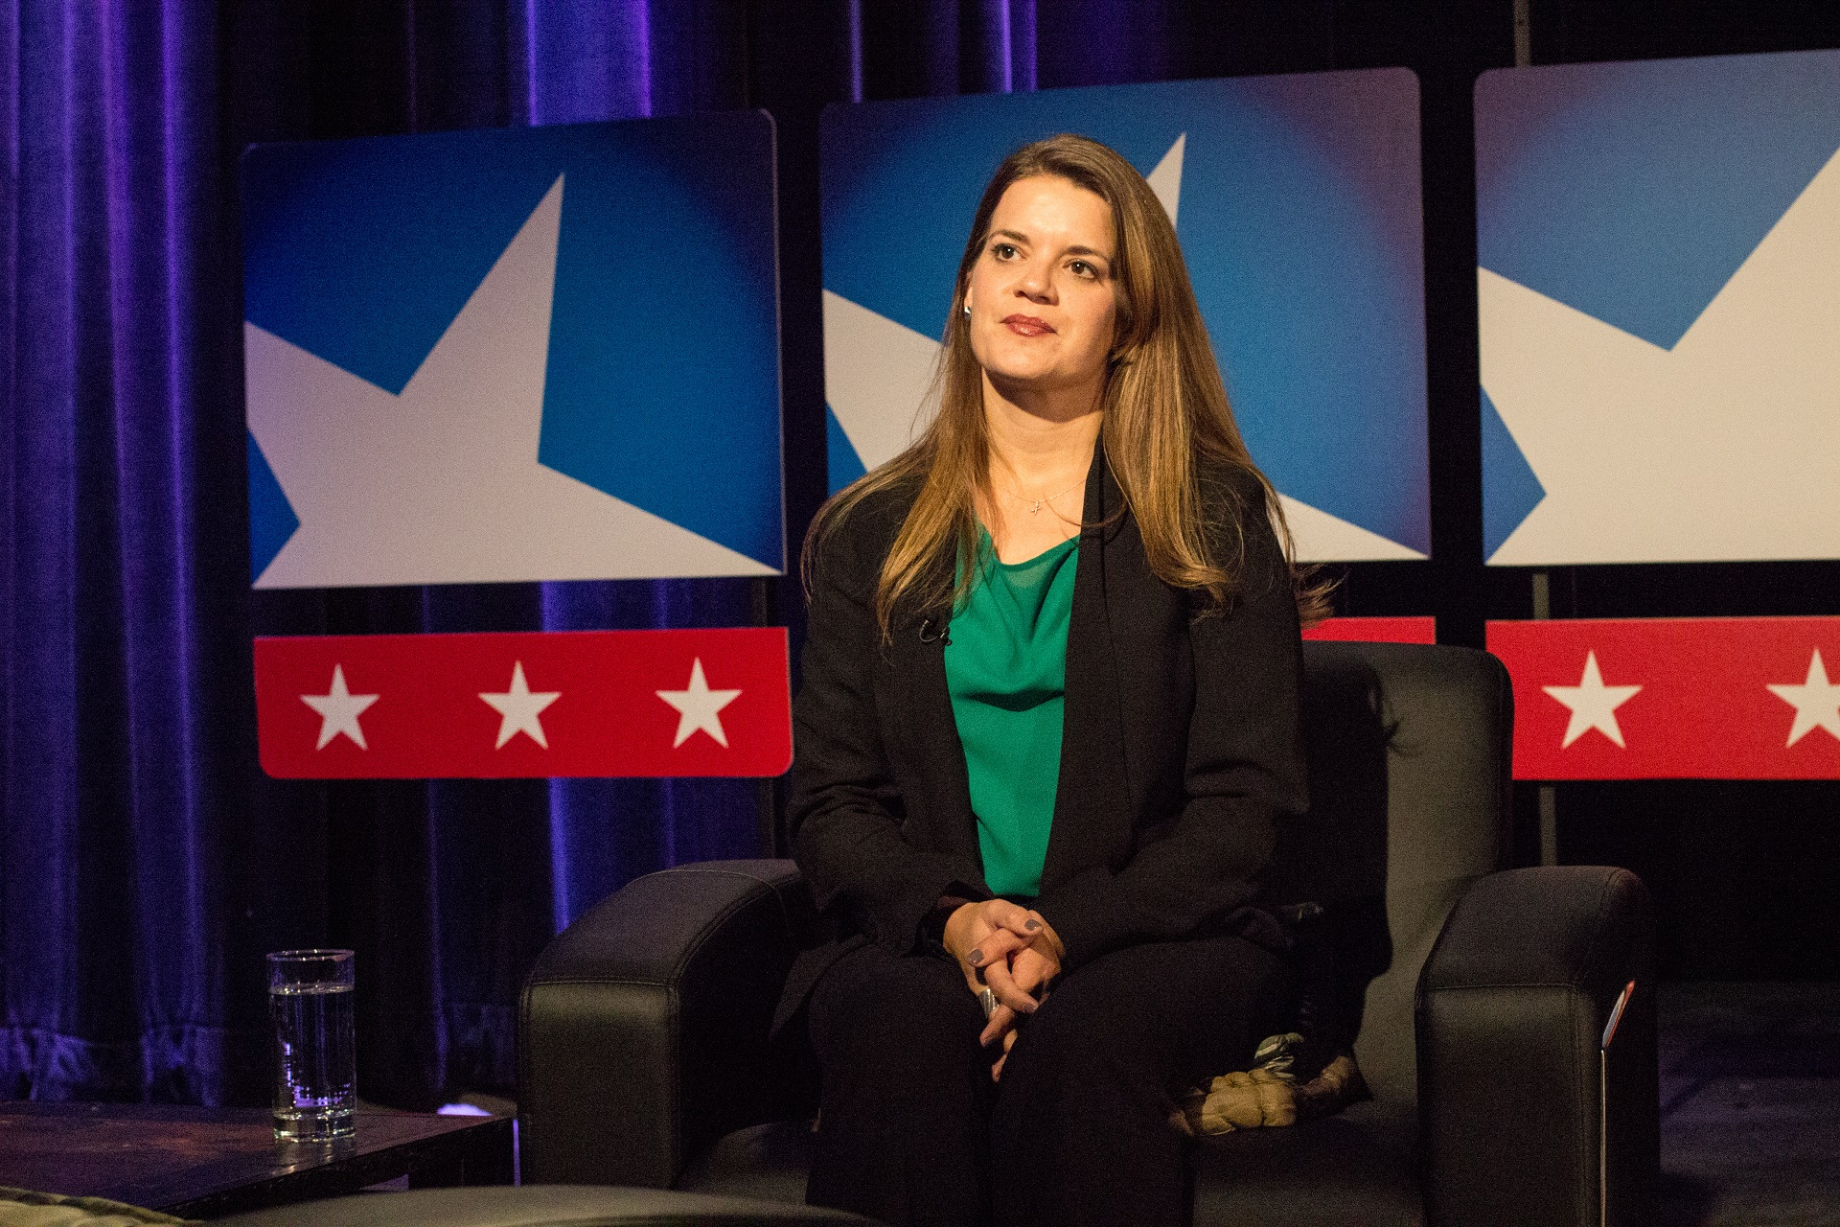

Hello There!
Maggie Toulouse Oliver
New Mexico Secretary of State
Notes:
This is Maggie Toulouse Oliver. She is our Secretary of State. Also happens to be New Mexico’s 26th and longest serving SOS.

Slide 5
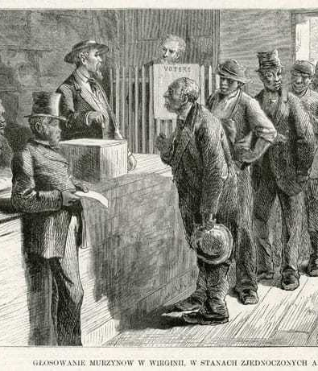
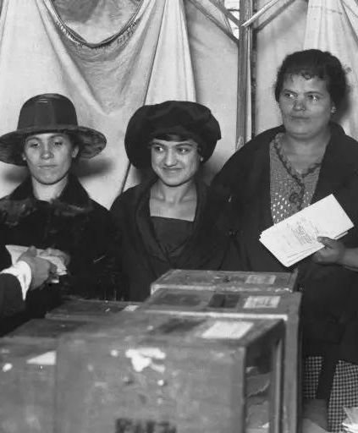
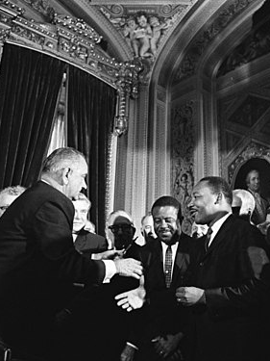
The Right to Vote has Been a Struggle Exercise your Right!
1870
1920
1965
Black men gained the right to vote.
Women gained the right to vote.
Voting Rights Act was signed.
Notes:
In the US, It's been a long and hard fought journey to secure equal voting rights for all people.
Let's take a look back at the giants whose shoulders we stand on today.
The country's first election was held in the winter of 1788, but it wasn't until 1870 (82 years later!) that Black men could vote. (15th Amendment to the US Constitution in 1870)
Still, barriers to the Black votes remained. Systemic racism, including poll taxes and literacy tests, suppressed their participation.
5 decades after Black men gained the right to vote, and 132 years after the first election in the US, women gained the right to vote in 1920, through the long and difficult fight that was the women's suffrage movement. (19th Amendment to the US Constitution in 1920)
After 1920, though, not all women could vote. Voter suppression tactic that suppressed Black men suppressed Black women too. Poll taxes, literacy tests kept Latinx women from casting their ballots. Native Americans, Asian American immigrants were denied citizenships, therefore were not granted the right to vote. It wasn’t until the Civil Rights Movement that substantial progress was made. The 1965 Voting Rights Act outlawed discriminatory practices that disenfranchised communities.
Despite these victories, the fight for equal voting rights continues to evolve today.

Slide 6
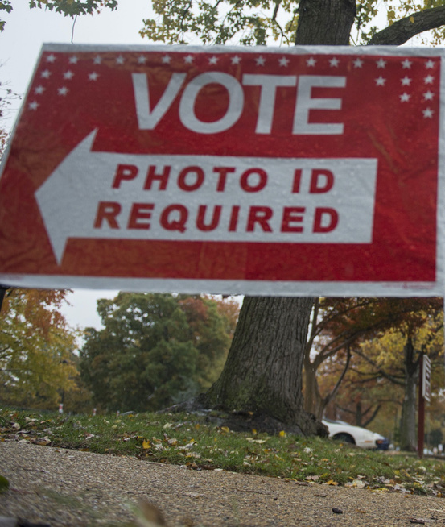
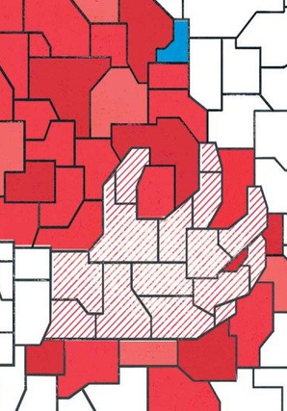
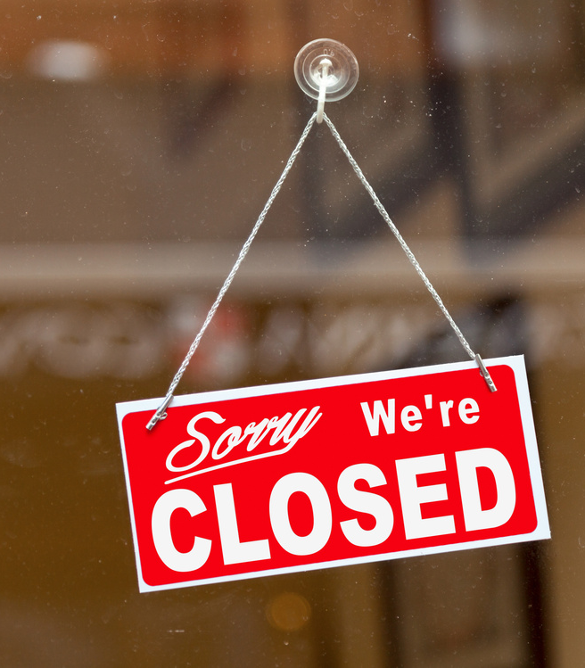
Voter ID laws
Modern-day
fight for equal voting rights
Gerrymandering
Voter suppression tactics
Notes:
Modern-day issues in the fight for equal voting rights in the U.S. include voter ID laws, gerrymandering, and voter suppression tactics.
Some states have enacted strict voter ID requirements, which disproportionately affect marginalized communities such as people of color, low-income individuals, and the elderly.
Gerrymandering, the manipulation of electoral district boundaries, is another issue, often leading to unequal representation in government.
Additionally, limitations on early voting, mail-in ballots, and the closure of polling stations in minority areas have raised concerns about access to voting.

Slide 7
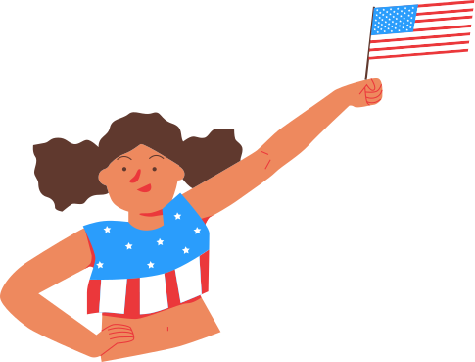
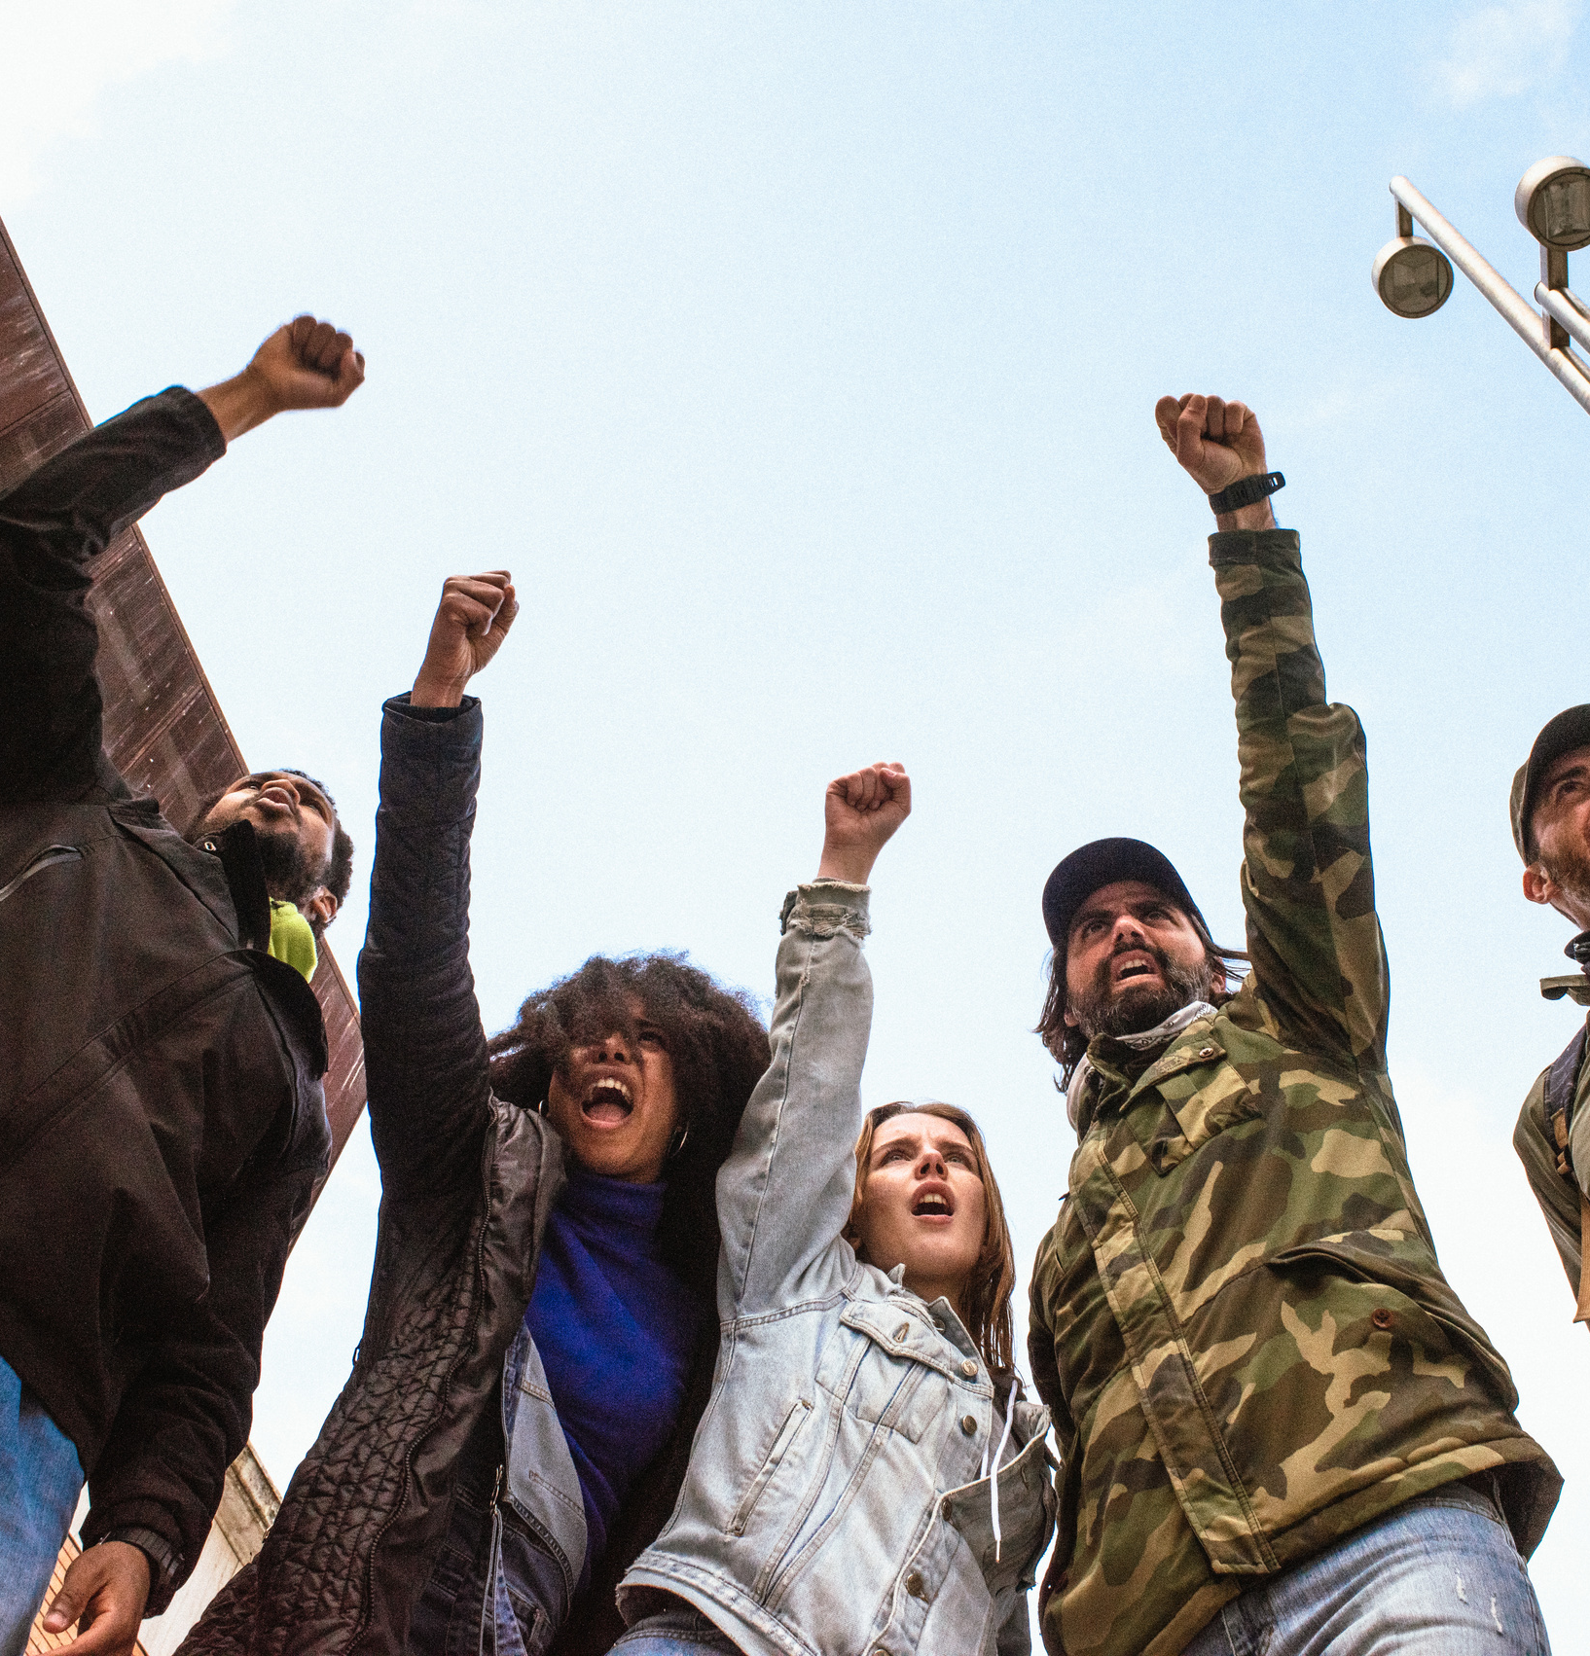
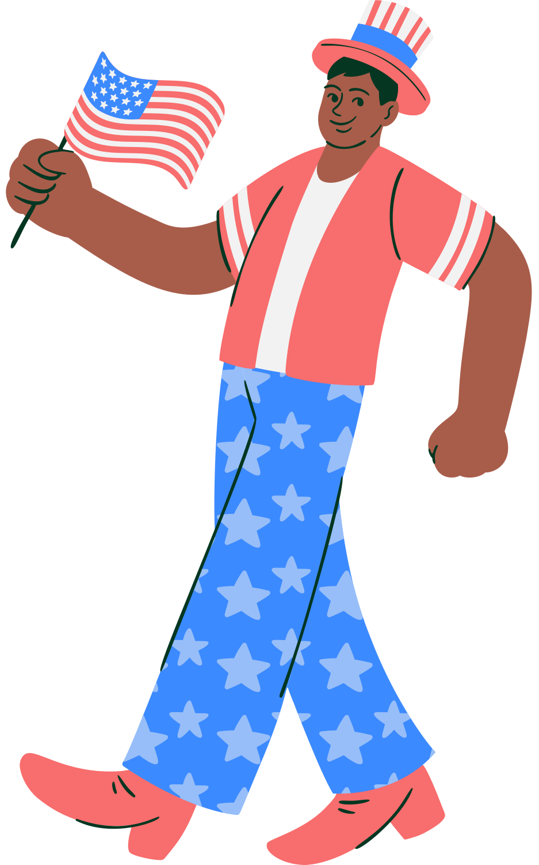
The fight continues!
Notes:
The fight continues. Across the country, there are debates over policies like automatic voter registration.
Or restoring voting rights for formerly incarcerated individuals.

Slide 8
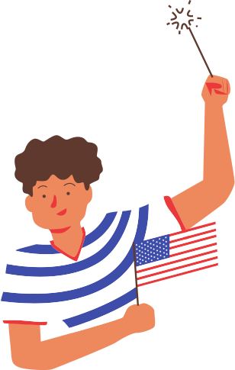
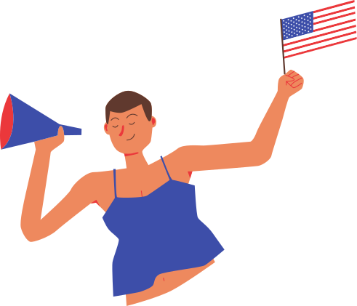
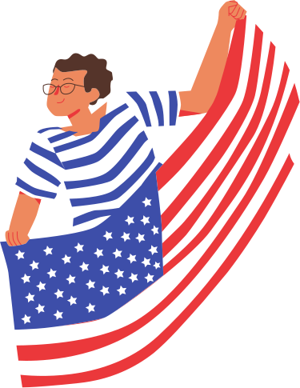
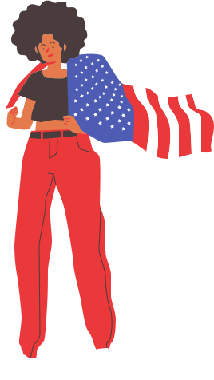
Lots of Ways to Participate Use them!
Vote early in-person
Vote in-person on Election Day
Register to vote!
Vote by mail
November 5
7am-7pm
NMVOTE.ORG
October 8-November 2
Using an absentee ballot
Notes:
In New Mexico, We make it as easy as possible to participate.
At the same time, we protect the integrity of every vote and make it hard to cheat.
If you remember one thing from today, remember NMVOTE.ORG –
You can go here to
1. register to vote or update your registration,
2. request an absentee ballot,
3. find polling locations near you,
4. view a sample ballot for the next election,
5. and more.
First step to participating in elections is registering to vote – You only need to do this once, not for every election.
Register to vote if you’ll be 18 by November 5! And I know from your teacher that there are 4/5 of you here who are already 18 or will be by November 5!
Vote early in-person during almost 4 weeks of early voting (Oct 8 - Nov 2),
vote by mail using an absentee ballot (or you can drop your completed absentee ballot off at any polling place in your county),
or vote in-person on Election Day, November 5 (polls open from 7am-7pm)

Slide 9
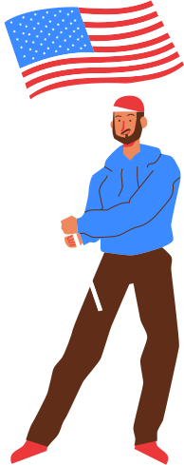
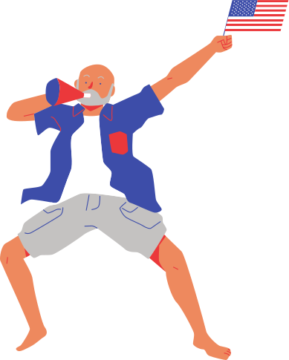

Same-Day Voter Registration
01.
02.
03.
New Mexico driver’s license or ID card
A document that contains an address in the county + photo ID
A valid student photo ID from a post-secondary educational institution in NM + a current student fee statement
Notes:
Since the deadline for registering to vote by mail or online at NMVOTE.ORG was October 8 – we will focus on Same Day Voter Registration
Same Day Voter Registration is available for eligible voters at your County Clerk’s office or at any polling location in your county on Election Day.
Check with your County Clerk for Early Voting locations that may also provide SDR by getting on Santa Fe County Clerk website.
Whether you are an unregistered voter or an already registered voter looking to update your registration, in order to use SDR you’ll need to bring:
(1) a New Mexico driver’s license or New Mexico identification card issued through the motor vehicle division of the taxation and revenue department; (2) any document that contains an address in the county together with a photo identification card; OR (3) a current valid student photo identification card from a post-secondary educational institution in New Mexico accompanied by a current student fee statement that contains the student’s address in the county.

Slide 10
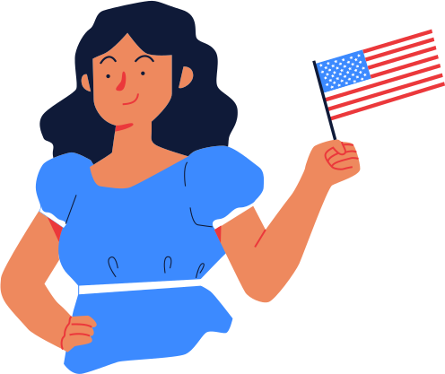
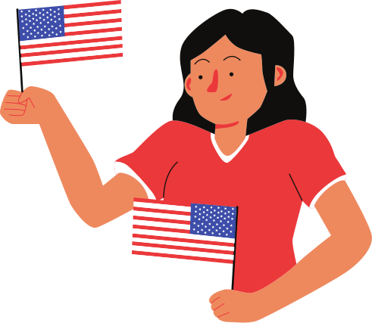
Absentee/Mail-In
Voting
01.
02.
Fill out application at NMVOTE.ORG
Contacting your County Clerk’s Office
Notes:
Absentee/Mail-In Voting – Any eligible voter can vote using a absentee ballot, this is what is known as “no-excuse absentee voting”
Request an absentee ballot by:
Fill out an application online at NMVOTE.ORG
Contacting your County Clerk’s Office in person, phone, mail or email

Slide 11

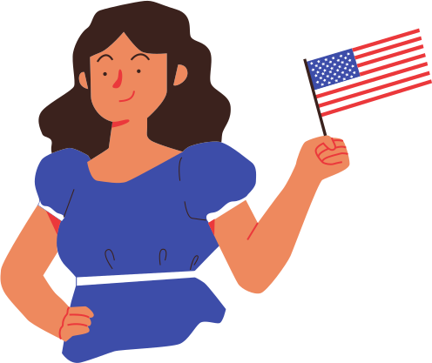
Track the status of your ballot
sos.nm.gov/trackmyballot
Notes:
Track the status of your ballot by visiting sos.nm.gov/trackmyballot after you’ve requested an absentee ballot

Slide 12
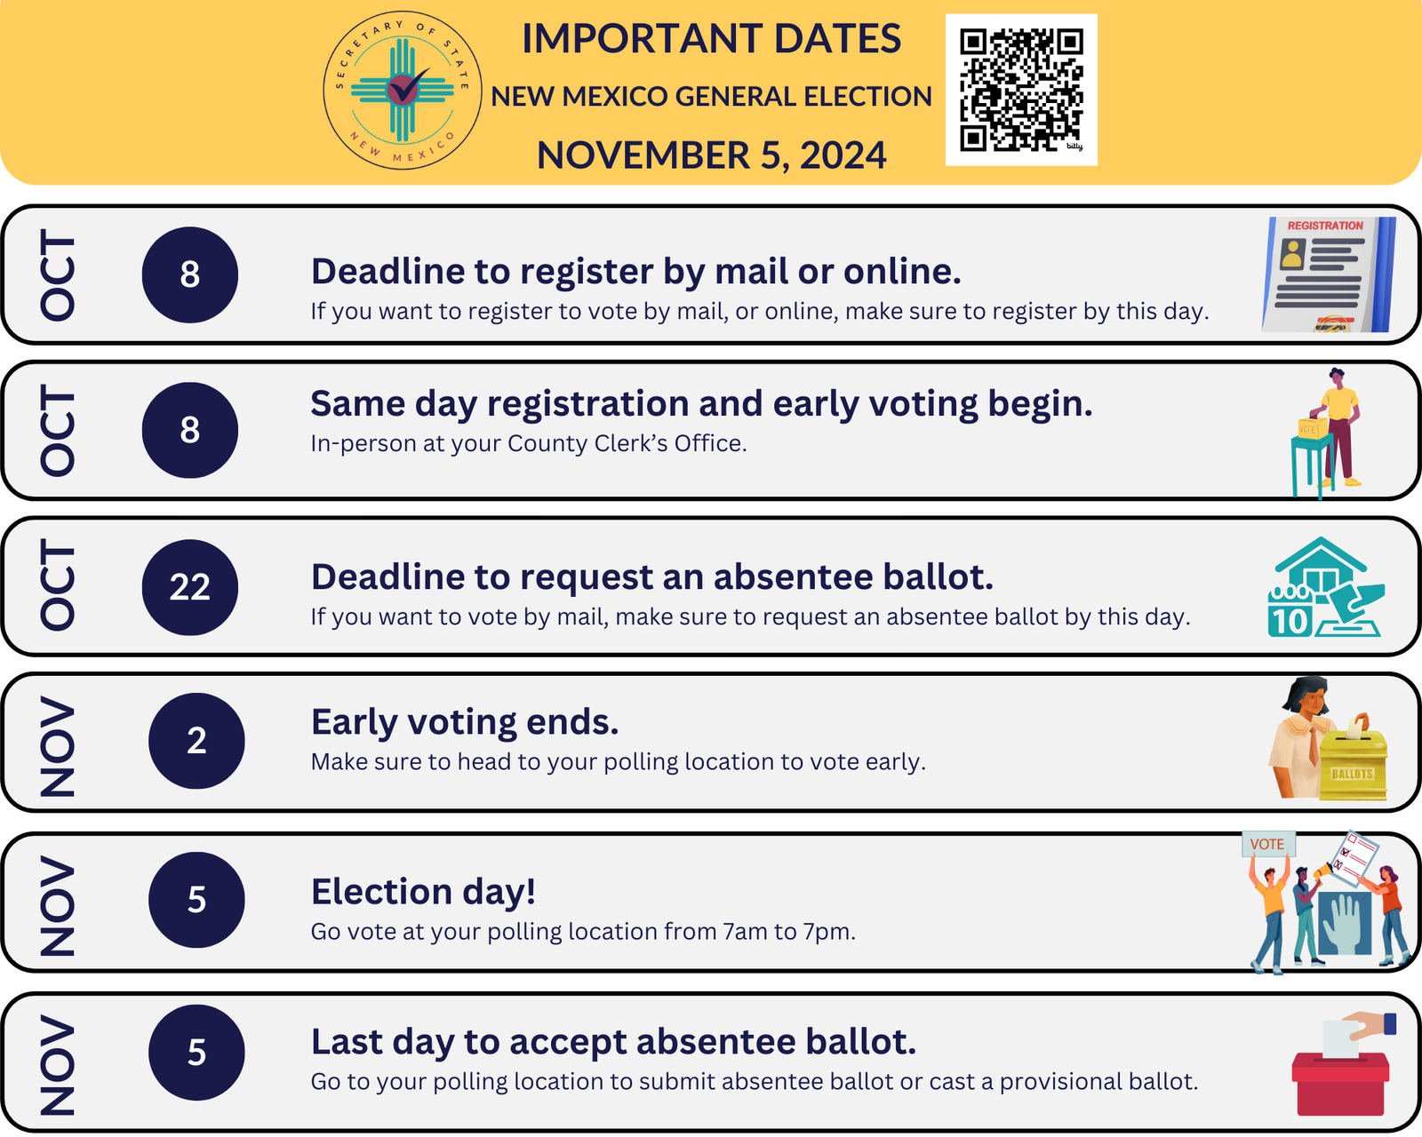
Notes:
● October 8 – Voter registration (by mail or online) closes.
● Same Day Voter Registration (SDR)is available for eligible voters at their County Clerk’s office or at any polling location in their county on Election Day. Check with your County Clerk for Early Voting locations that may also provide SDR.
● October 8 – First day of Early Voting (at the County Clerk’s office) and the first day that mail-in/absentee ballots can be mailed to voters (who have previously submitted an absentee application).
● October 19 – Expanded Early Voting begins at voting locations throughout your county.
● October 22 – Last day to request a mail-in/absentee ballot.
● November 2 – Last day of Early Voting.
● November 5 – General Election Day. Polls open 7:00am-7:00pm.

Slide 13
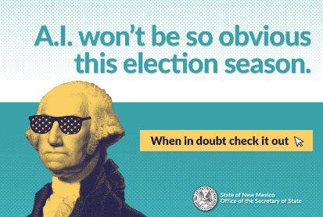

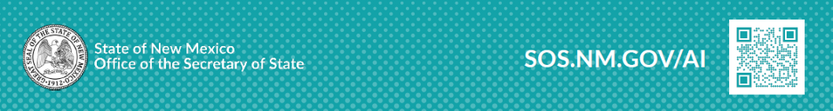
Notes:
As we near the 2024 elections, seeing is no longer believing.
A.I. tools have made it easy to make anyone do or say anything in photos, videos and audio. If left unchecked, A.I. could make it harder for us to distinguish between what is true and what is not.
The NMSOS wants to ensure voters have the tools and knowledge to combat deepfakes during this election season.
(Deepfakes are fake images, audio or videos that use real people in images and sounds to sway voters.)
We launched a public awareness campaign on AI and this year election: Visit sos.nm.gov/AI so you can:
1. Download our quick guide to spotting A.I.-generated content.
2. See if you can spot the A.I. generated images in a quick quiz.
3. If you come across something you think is A.I. misinformation this election season, we want to hear about it.
Email Elections@sos.nm.gov with a link to the image or video.

Slide 14
Thank
you!

